Slide 1


Ready For the Future By your Side
Rewan Mohamad & Ziead Shab Kalieh

Slide 2
About Us
Welcome to SuperEast, where cutting-edge technology meets exceptional service. Established with a passion for innovation, we are a leading provider of technology services dedicated to transforming businesses and empowering organizations.

Slide 3

Our Mission: Make Your Bussiness Better Through Technology.
Our Vision: Together we determine your Product Vision Based on Your Customer Needs and the Vision of the future of your Bussiness.

Slide 4
Our Goal
Develop The needed Solution Using Agile Methodologies.

Slide 5

Privacy
Security
Simple
Quick
Professional

Slide 6
Market Strategy Penetration
Price Adjustment
Augmented promotion
Distribution Channels
Knowing Risk and Growth
Be unique and think differently

Slide 7
Marketing Mix
Products
Programmabl USB Flash.
Remote USB Connecter Modem.
Access Your Virutal Computer by using QR Code.

Slide 8
Marketing Mix
Place
Price
Dubai
Electric Paying Like Paypal

Slide 9

Marketing Mix
Promotion
Offline
  Present offers For Companies
  Presentations
  Street Posters
Online
  Social Media Posts
  Google Ads
  Youtubers
  SuperEast Application.

Slide 10
 | Our company | (A) | (B)
Size | The number of our employees is between 200 and 220 | The number of our competitor employees is between 120 and 150 | The number of our competitor employees is between 220 and 250
Strengths | Quick Strong | Long Experience | Large
Weaknesses | junior | Local Old Method | High Price Slow
Value Propositions | Comfortable Trust | Cheap Price | Available Every Where

Slide 11
CRM (Customer Relationship Management) software: we are using CRM software like Telegram Bot
Customer Analysis

Slide 12


Slide 13
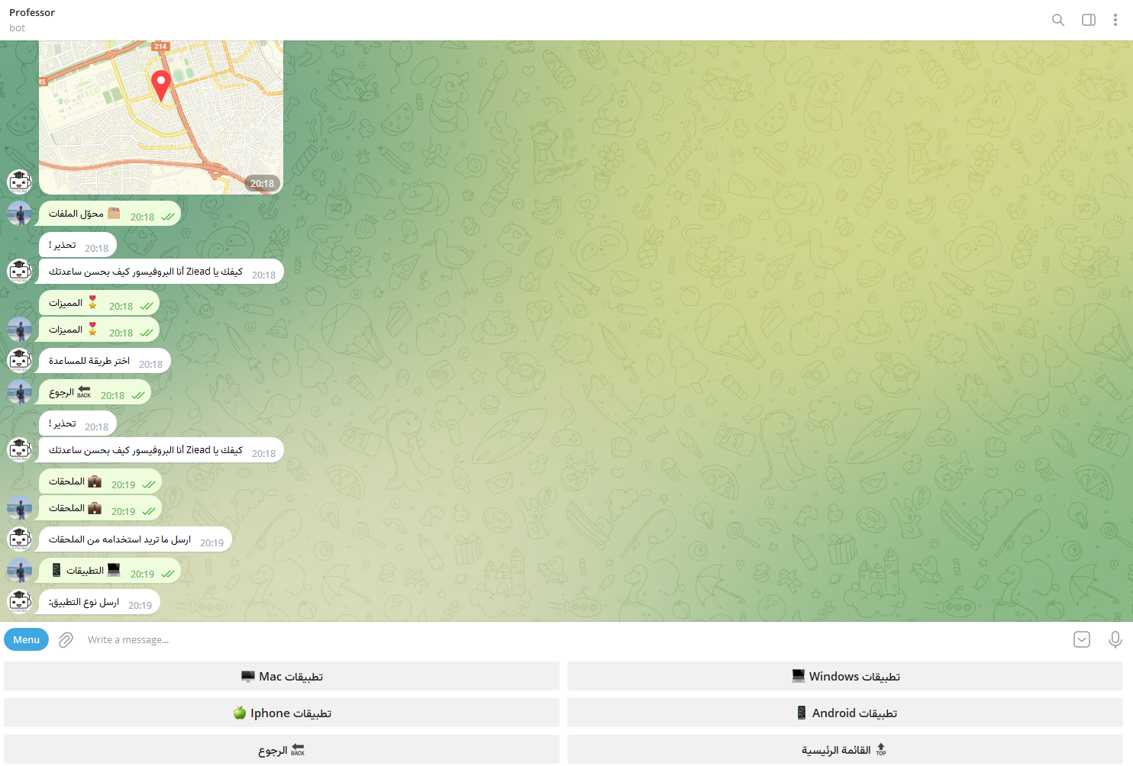
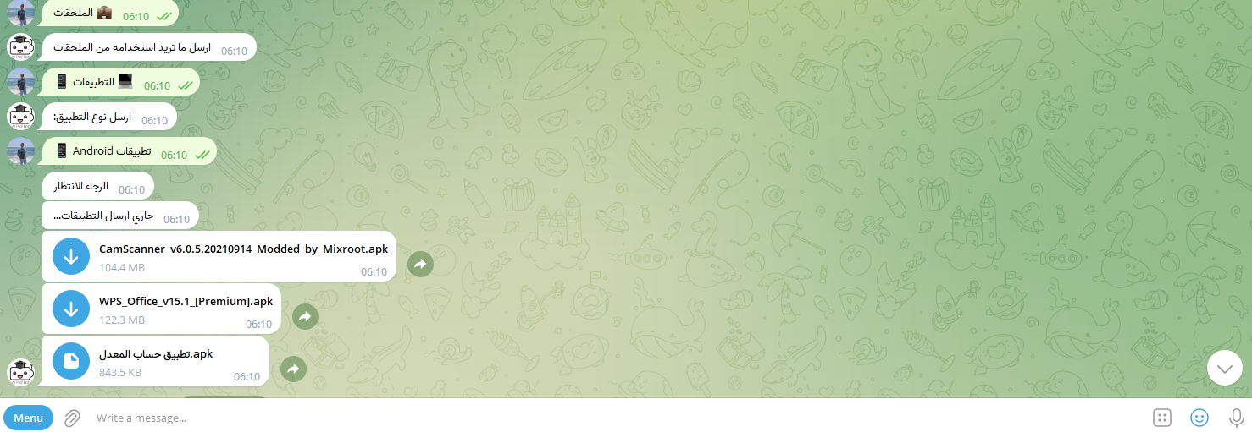

Slide 14
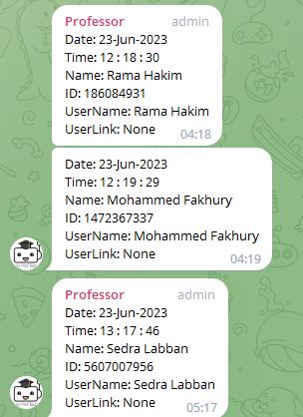
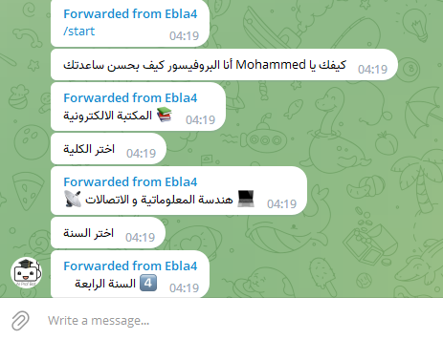

Slide 15
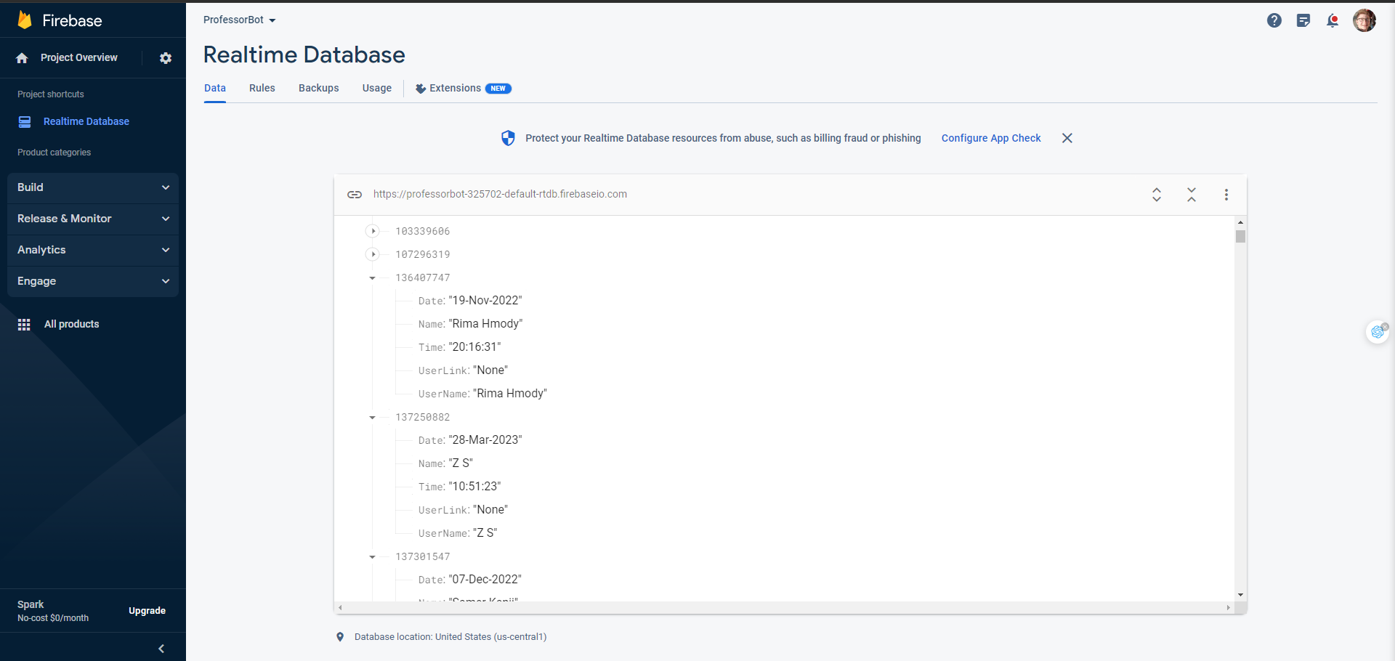

Slide 16
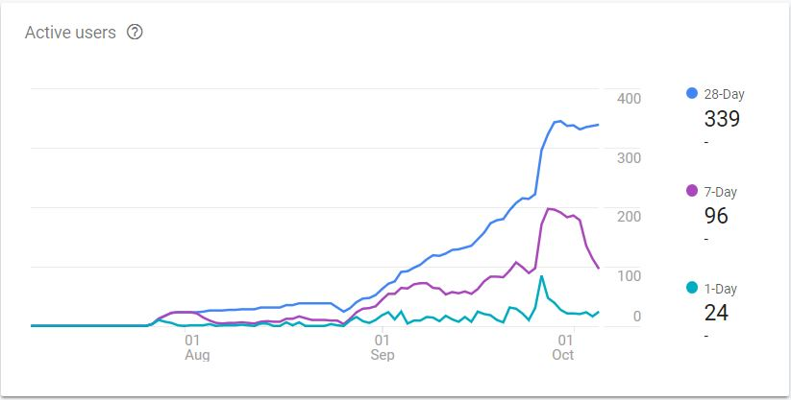

Slide 17
Customer Relationship
Butterflies: most active and engaged clients who use the software but they are not loyal to our company and there percentage is 10% | True friends: represent loyal clients who have taken multiple services and there percentage is 60%
Strangers: represent new clients who are just start using first service and there percentage is 3% | Barnacles: could represent clients who are not very engaged or have not satisfied with our service and there percentage is 27%

Slide 18

Services analysis
Economic benefits
Reduced Overhead Costs for Companies
Increased Productivity and Efficiency.
Functional benefits
More Flexible Work Hours
Access to a Wider Talent Pool
Emotional benefits
Reduced Commute Stress
Increased Flexibility

Slide 19
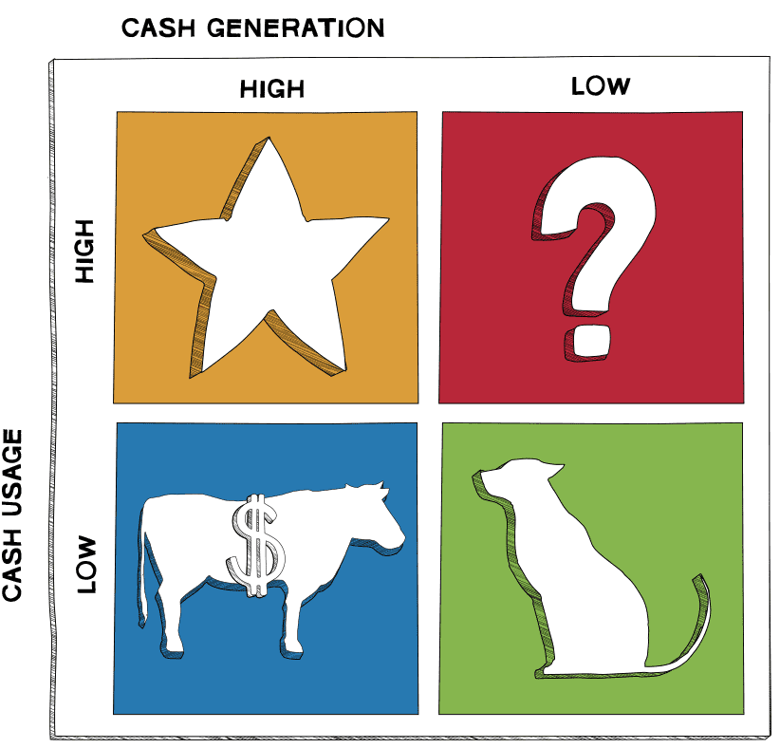
BCG matrix
1- STAR: our star service is the Programmable USB Flash.
2- CASH COW: it’s the Remote USB Connector Modem.
3- QUESTION MARK: it’s about accessing your Virutal Computer by using QR Code.
4- DOG: the Telegram Bot.

Slide 20
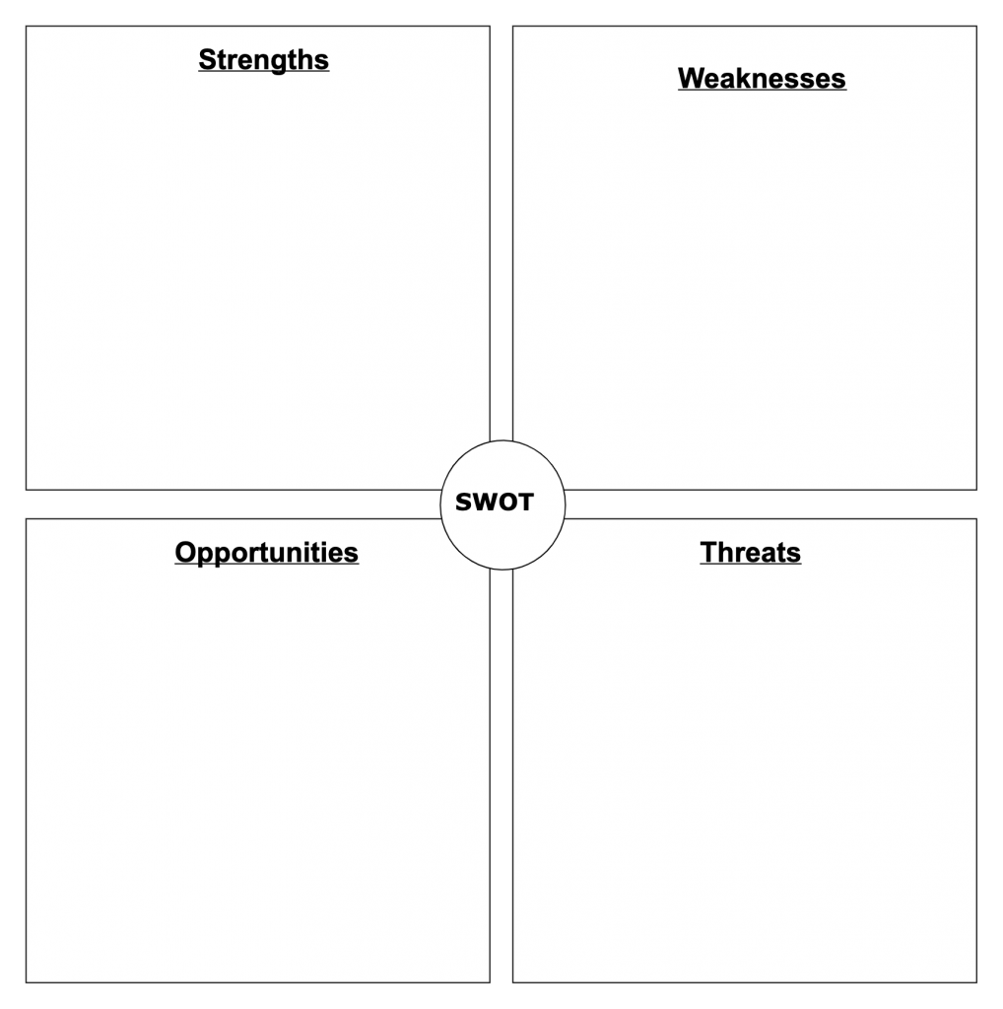
Strengths
Weaknesses
Competitive Prices
Available 24/7
Technical equipments.
Network Quality
SWOT
Opportunities
Threats
The center's location - the center's area is large, prepared to provide comprehensive services
Data security breaches.
Competitors with better research-intensive strategies.

Slide 21
Market Segmentation
Demographics: Lifestyle Stage: Companies
Geographic:
Location: Dubai
Behavior:
Confidence

Slide 22
Target Strategy
Our Approach Undifferentiated Marketing Processes
1: Comprehensive Market Research
  In-depth understanding of industry needs and pain points
  Analysis of emerging trends and technologies
2: Holistic Product Development
  Agile and iterative software development methodologies
  Focus on user-centric design and seamless user experience

Slide 23
3: Robust Quality Assurance
  Rigorous testing and QA protocols to ensure reliability and performance
  Continuous feedback loops for refinement and optimization
4: Strategic Go-to-Market Strategy
  Customized marketing campaigns tailored to specific target segments
  Leveraging digital platforms, social media, and industry events
5: Exceptional Customer Support
  24/7 customer support for prompt issue resolution
  Proactive engagement for customer satisfaction and loyalty

Slide 24
Thank You
Hope you enjoy our Project

